Slide 1

PageUp User Guide – Hiring Managers and Search Committee Chairs
Requisition Process, Job Posting, and Applicant Management
Human Resources Department
People and Workplace Culture
Notes:
Note, these pptx modules are to be viewed from the perspective of the hiring manager.

Slide 2
Table of Contents
Introduction, page 3
How to Log into PageUp , pages 4-5
Dashboard, page 6
Requisition Approval Process , pages 7-17
Applicant Management and Moving Through Workflows, pages 18-34
Submitting a Hiring Recommendation, pages 35-39

Slide 3
Introduction
Welcome to Colorado College's PageUp User Guide: Staff Edition for hiring managers and search committee chairs.
The purpose of this user guide is to help provide clarification and increase efficiency with this applicant tracking system to ensure a smooth hiring process. If you have questions, concerns, or suggestions for the PageUp User Guide, please contact the Talent Acquisition Specialist, Missy Liu.
At Colorado College, we are dedicated to dismantling systemic and institutional discrimination. We embrace diversity and support a community where all individuals, without exception, feel valued, empowered, and treated equitably. Guided by the College’s Antiracism Plan, we work to foster an equitable and inclusive environment for all who teach, learn, work, and live in our community.
Colorado College is committed to equal opportunity for all employees and applicants in all aspects of the employment relationship—including (but not limited to) recruiting, hiring, promotions, compensation, benefits, and access to training—without regard to race, creed, color, caste, religion, national origin, ancestry, sex (including pregnancy, gender identity or gender expression, perceived gender, sexual preferences and sexual orientation), disability, marital status, veteran status, age, genetic information, or any other status protected by federal, state, or local law.

Slide 4
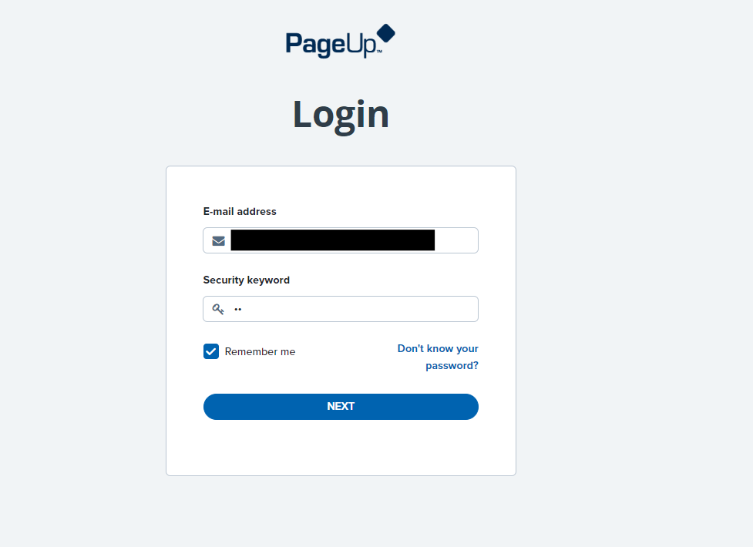
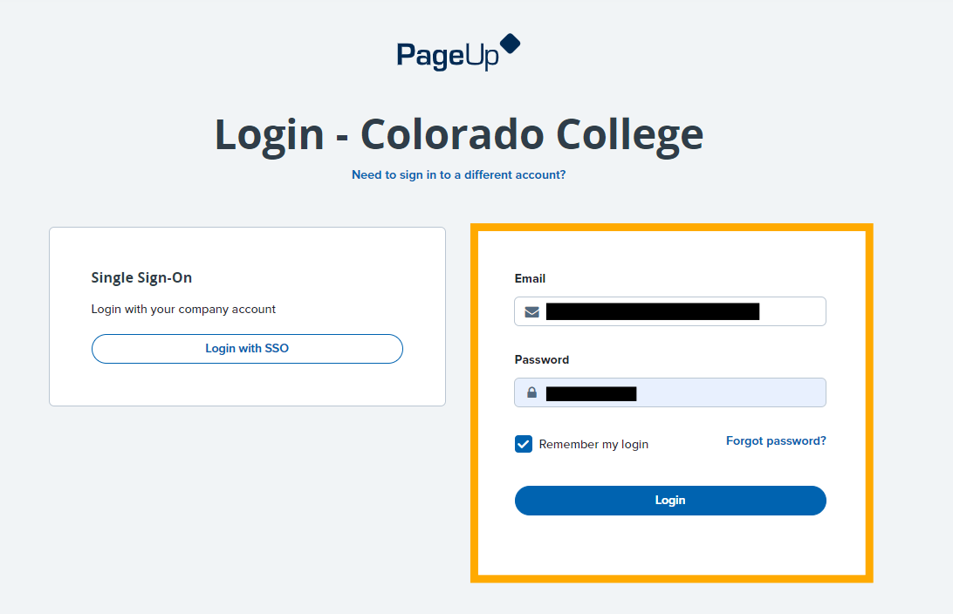
How to Log in to PageUp
You can view your job posting and dashboard on our new portal, PageUp!
Your login email is your CC email address, security code is cc (all lowercase, no spaces, no additional characters)
This will bring you to another sign in option. Do not click "Login with SSO"; Instead log in with your CC email address, and your regular CC password

Slide 5
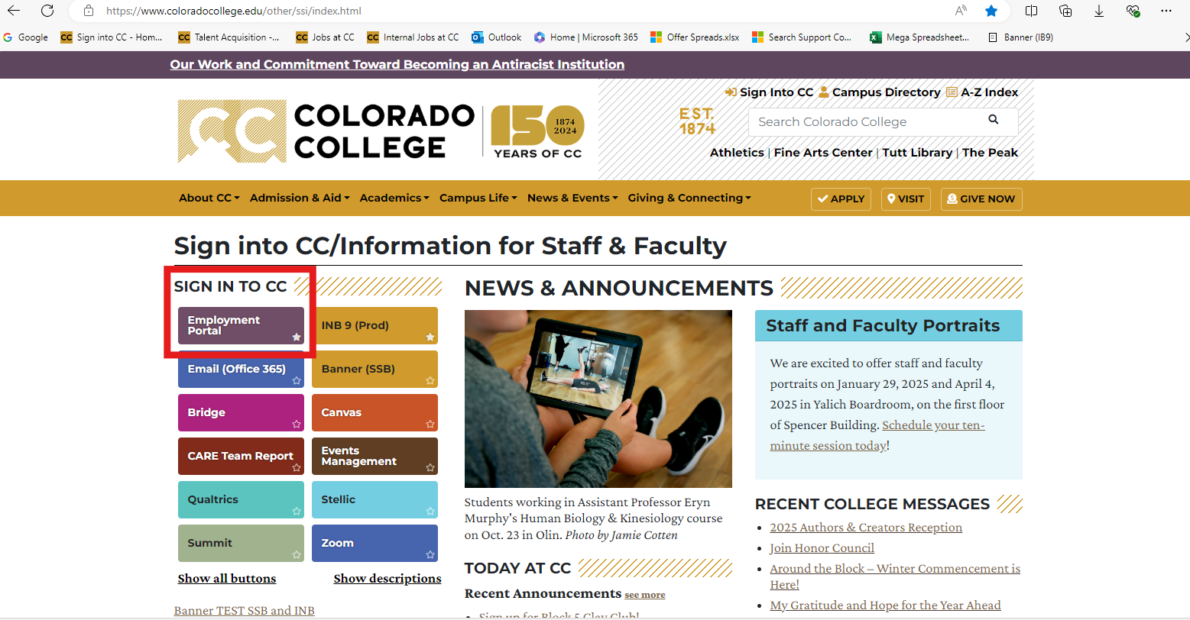
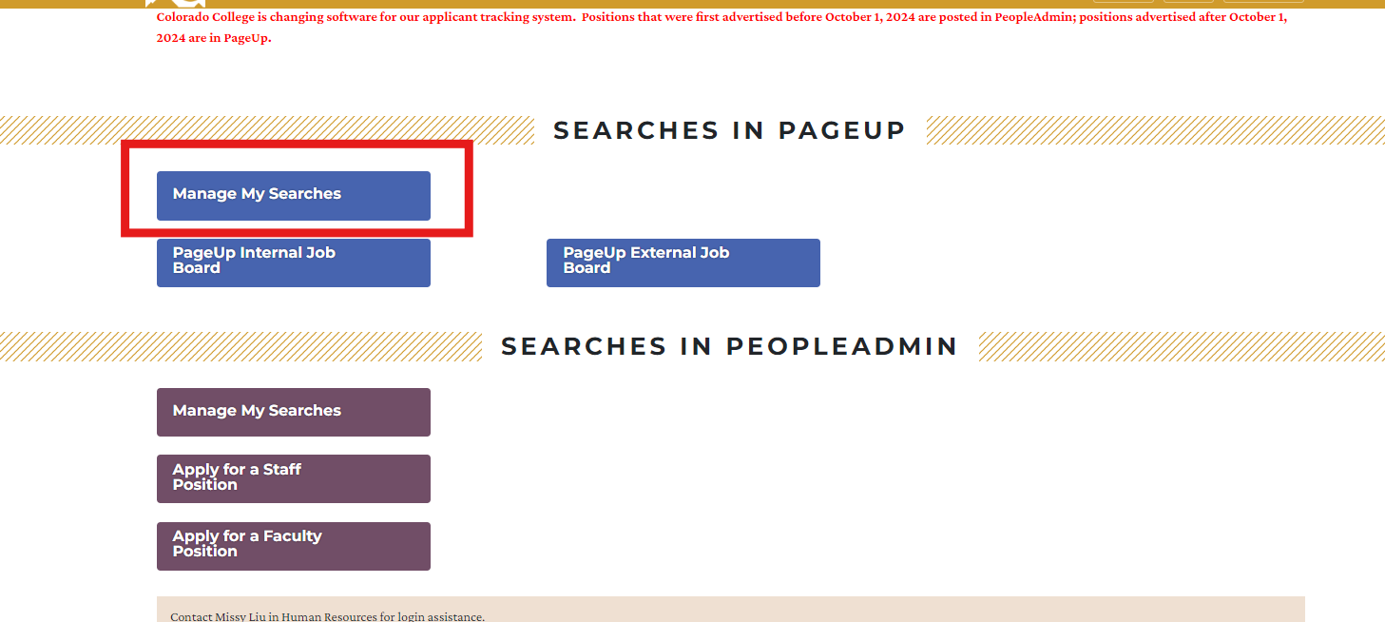
How to Log in to PageUp
Note that this employment portal can also be found on CC's single sign-on page. Click on "Manage My Searches" (highly recommend bookmarking these pages)!

Slide 6
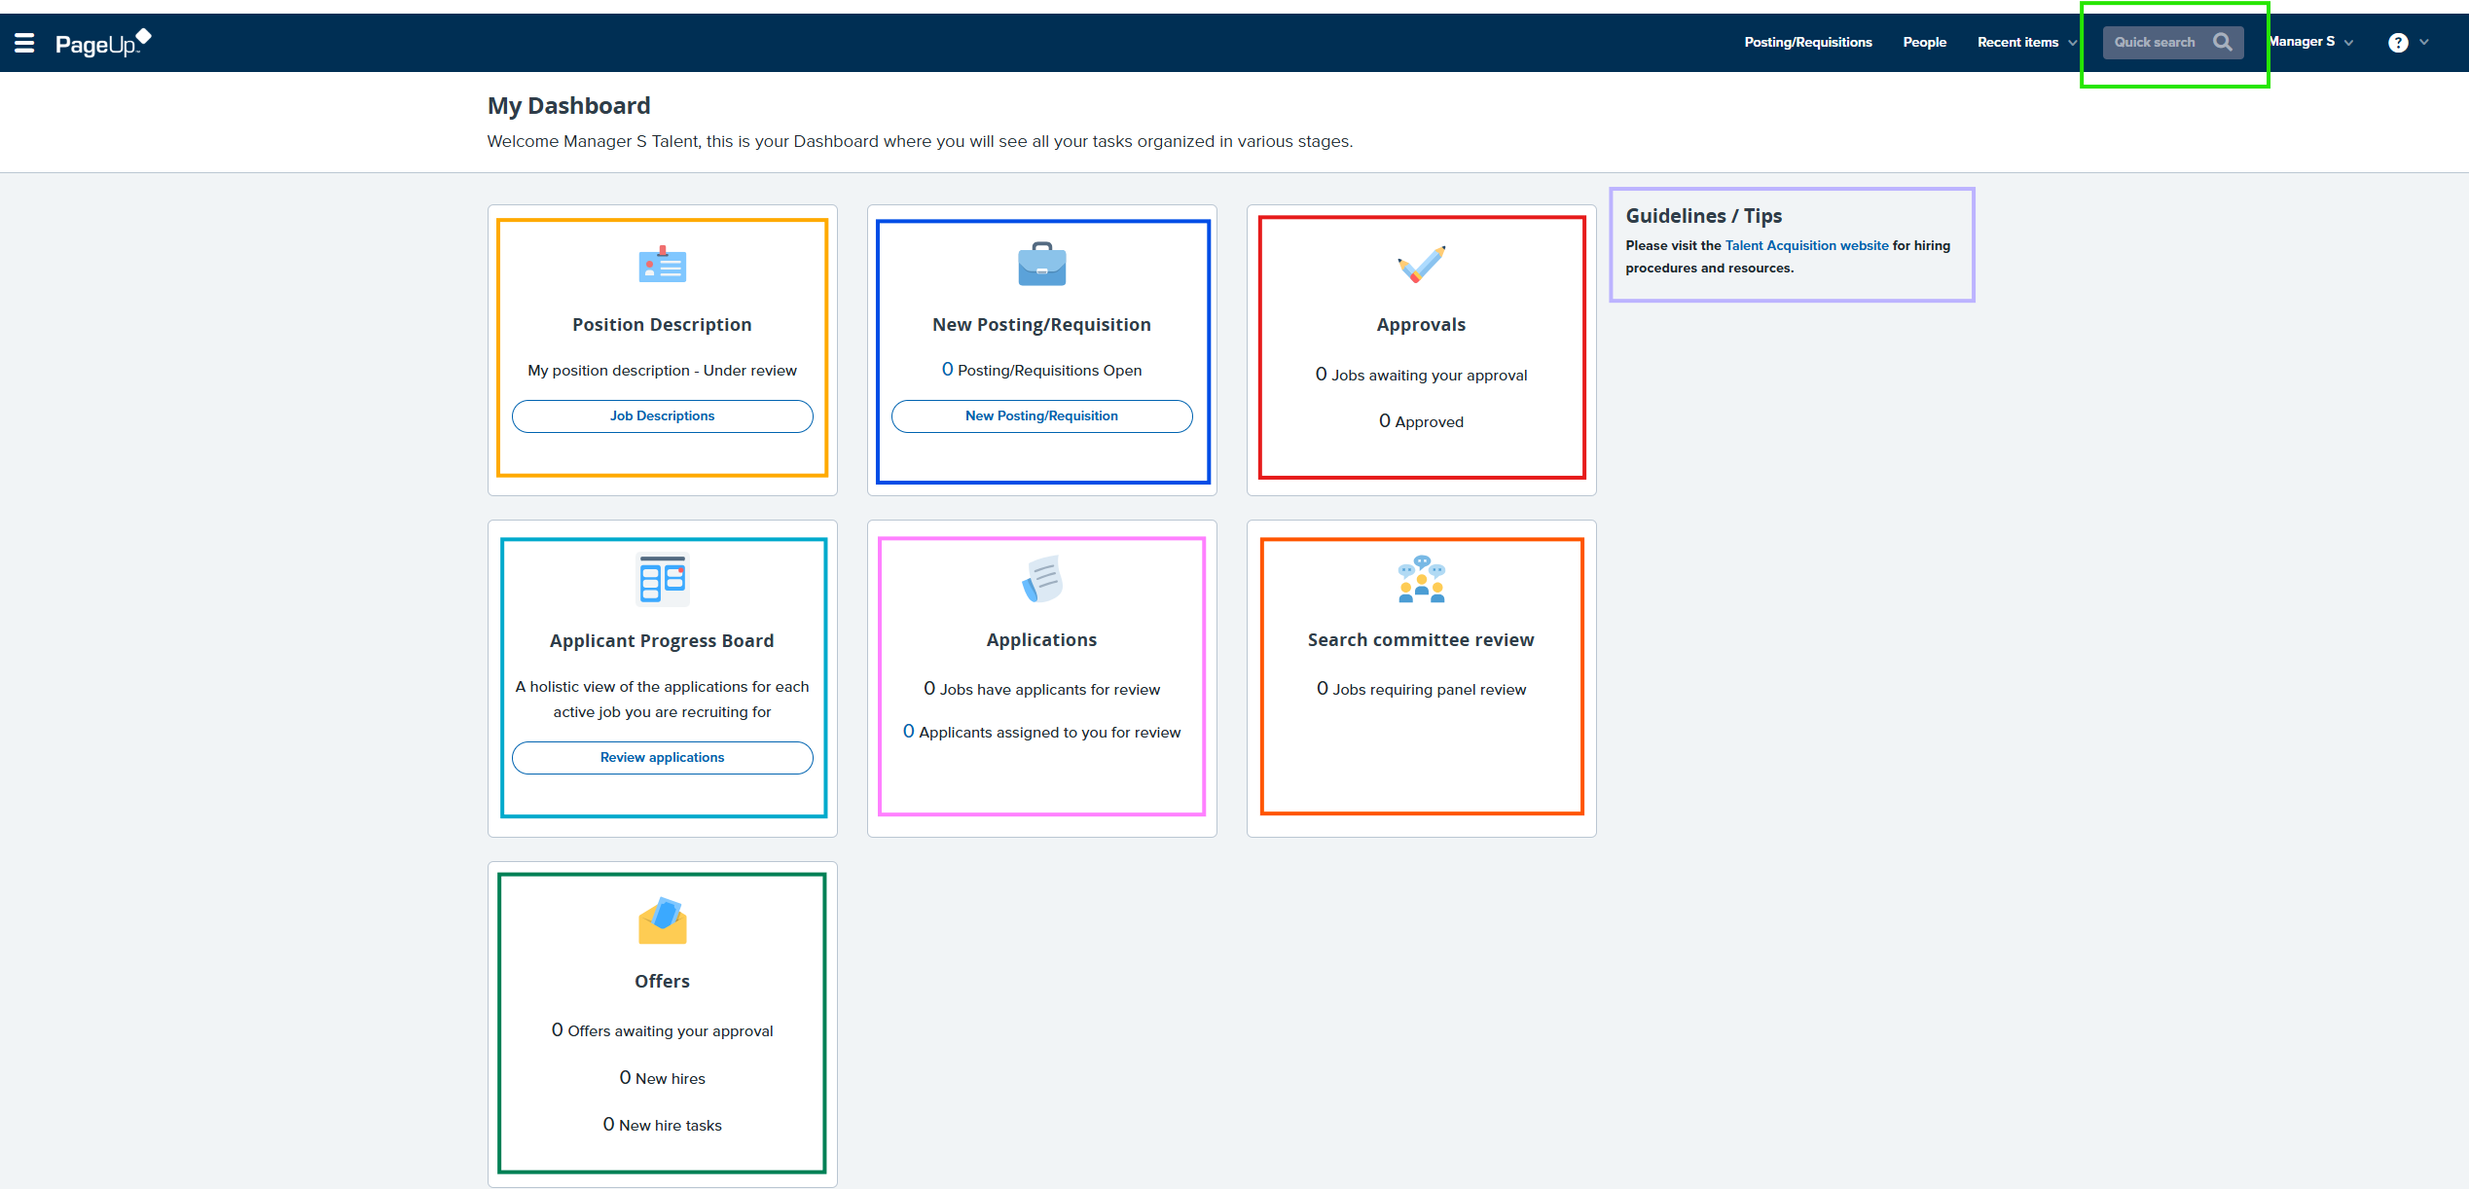

This is your dashboard.
Search job titles or candidate names
Click this to return to your dashboard at any time
Link to the CC Talent Acquisition website for tools and resources
Position Description – We don't currently use this but will in the future.
New Posting/Requisition - Here you can see how many jobs/requisitions you have open. Click on "Posting/Requisitions Open" to open the jobs. You will not be using the "New Posting/Requisition" button at the bottom.
Approvals - When a job requisition is ready for you to approve it will show up under "Approvals." Click on "Jobs awaiting your approval."
Applicant Progress Board – This is one way to view applications and move them through the hiring process. You can filter through your jobs in the top left by job title.
Applications – We don't currently use this.
Search Committee Review – As the search committee chair this is where you will go to review applicants and to see the reviews from other search committee members.
Offers – You won't use the "Offers awaiting your approval". Once your candidate has accepted the offer, you will see them under the "New hires". "New hire tasks" will show all the outstanding tasks either the new hire or the hiring manager needs to complete.

Slide 7
PageUp User Guide
Requisition Approval Process (previously the SPAF)
Human Resources Department
People and Workplace Culture
Notes:
Note, these pptx modules are to be viewed from the perspective of the hiring manager.

Slide 8
Requisition Approval Process
Updating the Job Description
New Job Opportunity - New or Vacant Position (Internal or External Posting)
  To obtain the job description, please email Pam Butler.
  Please edit or approve the job description and send back to Pam.
Promotion or Significant Job Change (Internal Posting)
  When requesting an employee promotion or significant job change (title change, job responsibility updates, new pay, etc.) please email Pam Butler to obtain the job description.
  Please edit or approve the job description and send back to Pam.
  All job postings must be posted for 5 a minimum of days to comply with the Colorado Equal Pay for Equal Work Act.
Other Considerations – Temporary Positions, Simple Job Changes (No Posting)
  The first step when requesting temporary positions or making simple job changes (supervisor changes, hour changes, etc.) is updating the job description. To obtain the job description, please email Pam Butler.
  Please edit or approve the job description and send back to Pam.

Slide 9
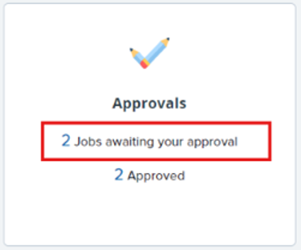
Requisition Approval Process
Once the job description is approved, the HR team will start a Job Requisition Form in PageUp that goes through a series of approvers (previously the SPAF). This form will circulate through the appropriate signers and once finalized, will come back to the Talent Acquisition Specialist to begin the job posting phase.
When the job requisition is ready to review, you will receive an email notification with the subject line "Requisition for Review". There is a link in the email that brings you to the requisition or you can log in to PageUp.
You have 2 options to approve the requisition.
  Reply "approve" to the email
  Log in to PageUp and approve
Click on "Jobs awaiting your approval"

Slide 10
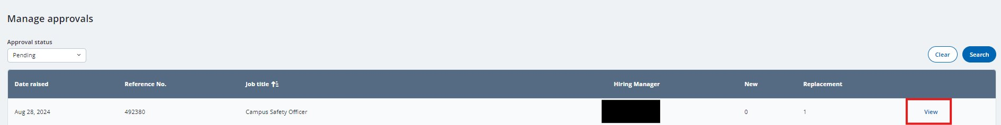
Requisition Approval Process
From here, click on "View" next to the job needing approval.

Slide 11
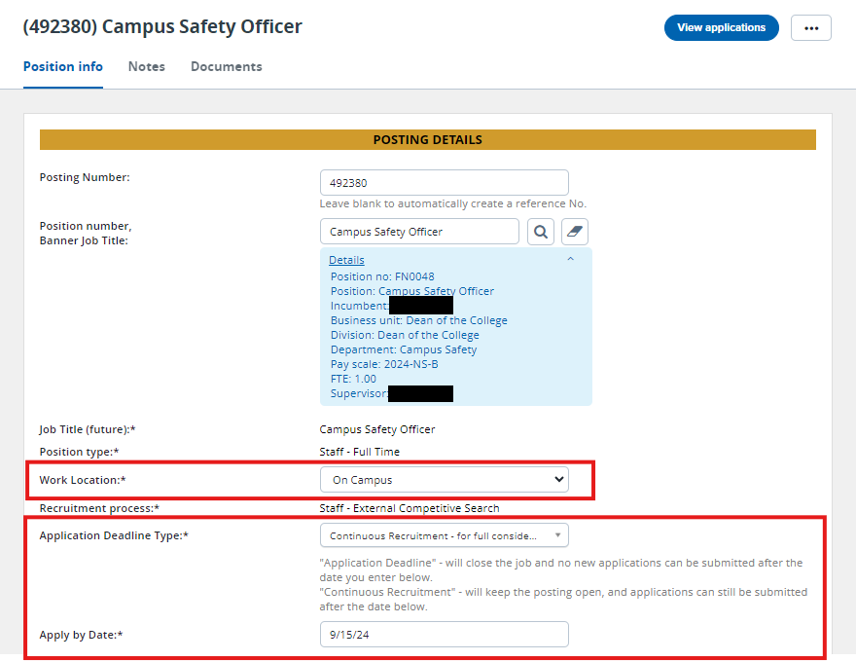
This will bring you to the Requisition. The first section is Posting Details. Please review the posting details and update the areas in red if needed.
Per the Equal Pay for Equal Work Act, all job postings must now include a good faith estimate of the date an application window is anticipated to close.
Language like "open until filled" is NOT compliant.
Application Deadline Type:
Application Deadline – This will put a hard close on the job posting on the specified date.
Continuous Recruitment- This will keep the job posting open to new applicants, but a full consideration date is listed. Meaning applications after the date don't need to be evaluated but can be.

Slide 12
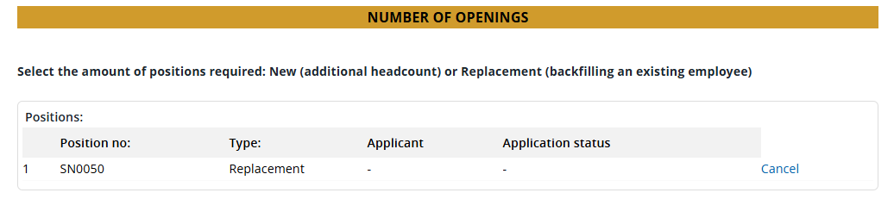
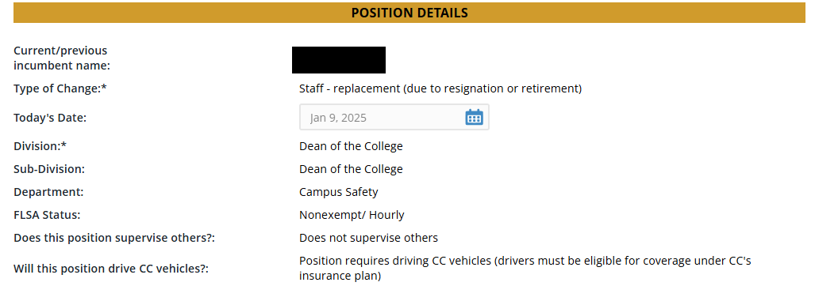
Requisition Approval Process
Next, is the Number of Openings and Position Details section. Please make sure the details are correct. If something is incorrect, please email Talent Acquisition.

Slide 13
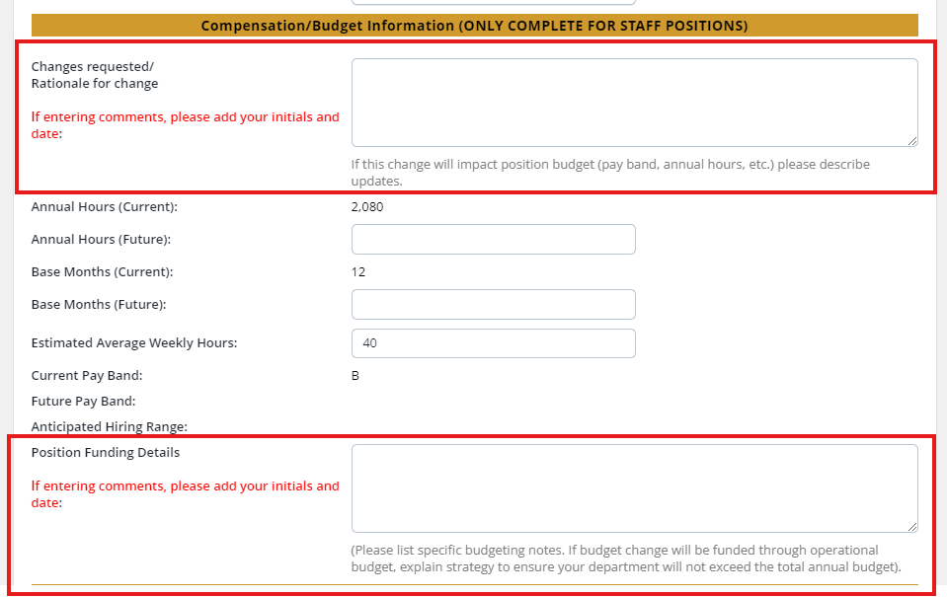
Requisition Approval Process
The compensation/budget information will have areas where you can make comments about changes requested/rationale for change, and position funding details if needed. Be sure to include your initials and date if leaving a comment.

Slide 14
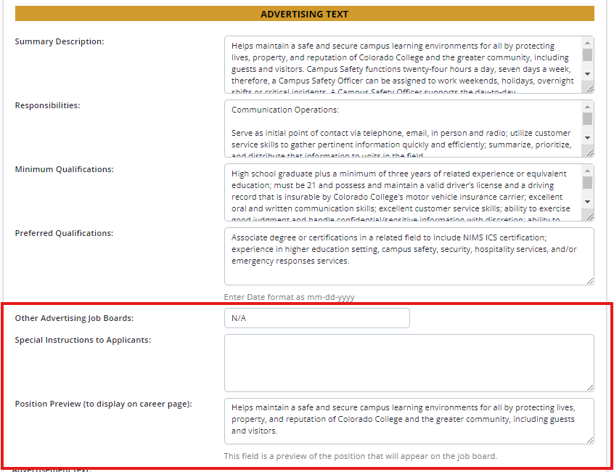
In the Advertising Text section, the summary description and position preview will be the same. This will be prefilled with a compelling summary for the job ad. Please make any changes you would like.
The responsibilities, minimum qualifications, and preferred qualifications are pulled from the job description. If you need to make changes to these areas, please do so in this section.
Include any additional job boards you would like to post on (include URL) and special instructions to applicants.

Slide 15
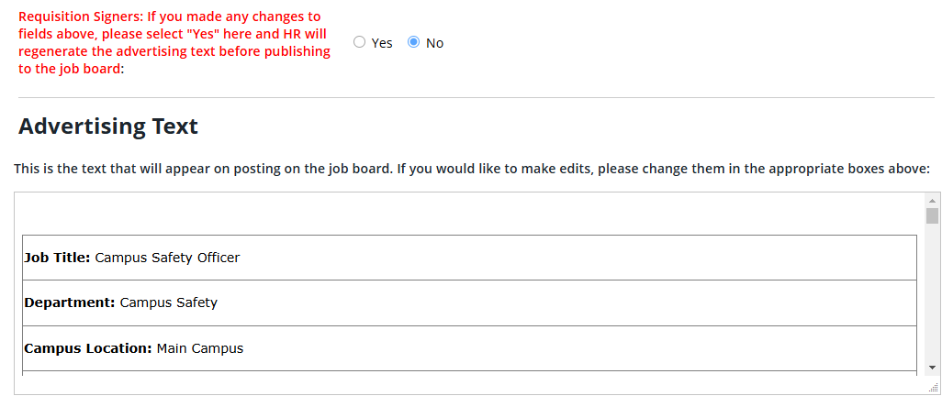
Requisition Approval Process​
If you made any changes or additions to the Advertising Text, please select "yes". This will let HR know that there is an update. If "no" is answered the advertising text will remain the same.
The Advertising Text will show you how the job will look on the job board. Once you add an apply by date (on the top of the requisition), HR will add it to the advertising text.

Slide 16
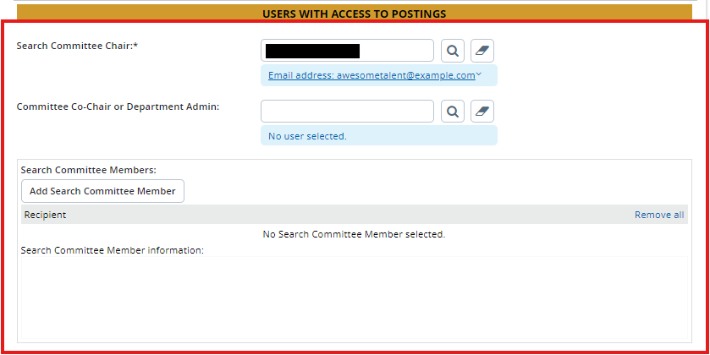
Requisition Approval Process​
Next, select who will be the search committee chair, if not you. You can also select a committee co-chair or department administrator. This person will have access to move applicants through the workflow in PageUp.
Finally, select who will be serving on the search committee. If you are not sure, they can be added later by the Talent Acquisition Specialist.

Slide 17
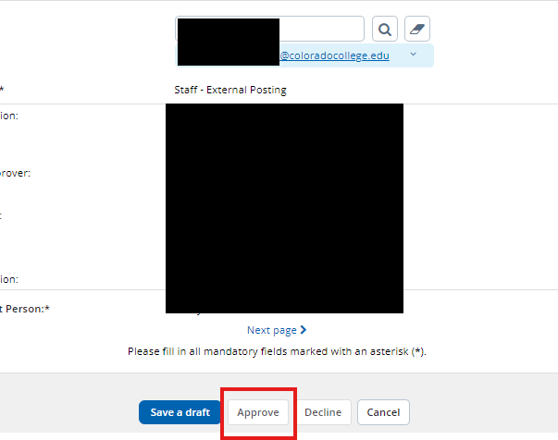
The last section on the requisition card shows the approval process (the hiring manager will typically see their name in step 2). After you have reviewed the posting and everything is to your liking, click "Approve" and it will go to the next person in the approval list.
When all the approval signatures are collected, the Talent Acquisition Specialist will then be notified to post the position, and an email will go to the hiring manager and/or search committee chair confirming it has been posted with additional next steps.

Slide 18
PageUp User Guide
Applicant Management and Moving Through the Workflows (Application Statuses)
Human Resources Department
People and Workplace Culture
Notes:
Note, these pptx modules are to be viewed from the perspective of the hiring manager.

Slide 19
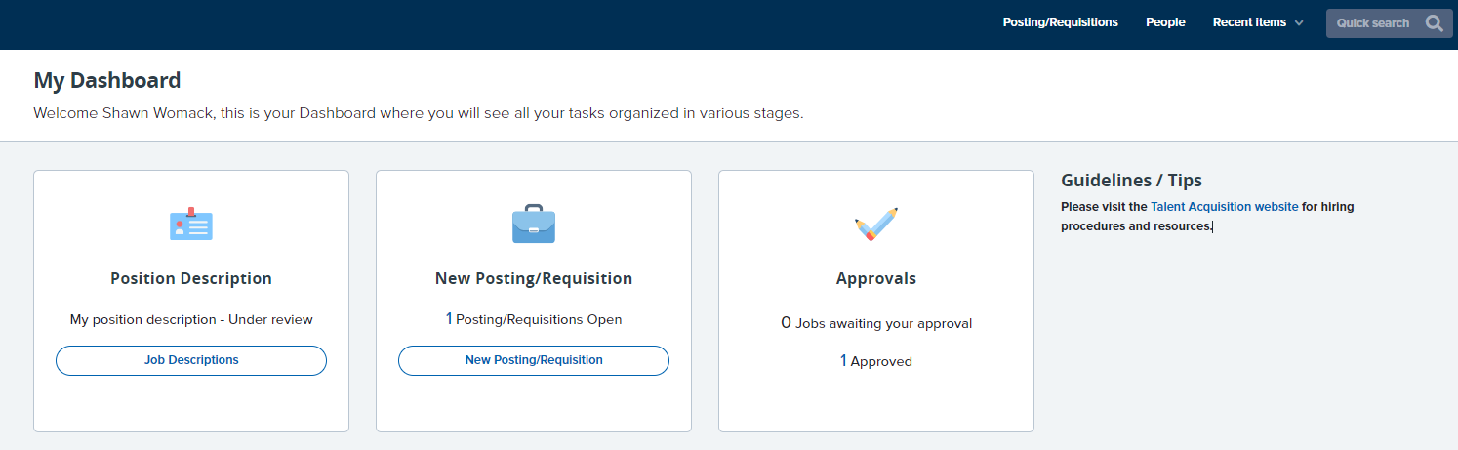
Viewing the Job Posting
After you receive a confirmation email from the Talent Acquisition Specialist that the job has been posted, double check that you can see it by logging into PageUp, and viewing it from your dashboard. There are two ways to view this:
Option 1: Click "[number] Approved" in the Approvals box.
Option 2: Click "[number] Posting/Requisitions Open" in the New Posting/Requisition box.

Slide 20
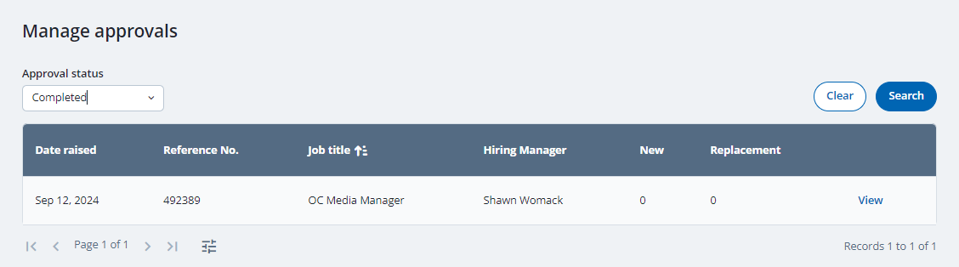
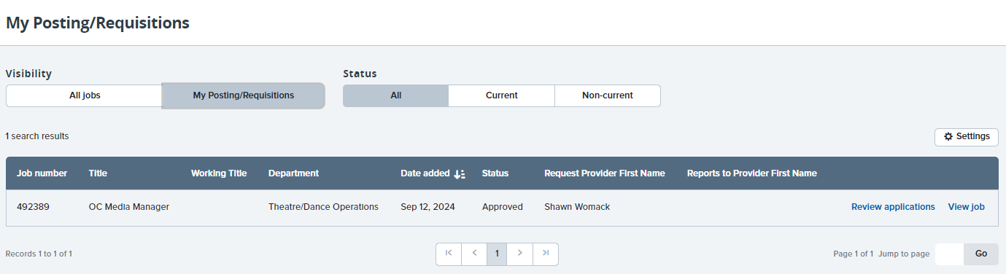
Viewing the Job Posting
Option 1: Clicking " [number] Approved" in the approvals box. Select "View" to view the posting details, compensation info, advertising text, and more.
Note: In the "Approval status" drop down menu, select pending to view postings still in the approval process
Option 2: Clicking " [number] Posting/Requisitions Open" Select "View Job" to view the posting details, compensation info, advertising text, and more.
Note: Option 2 also provides a pathway to "Review Applications"

Slide 21
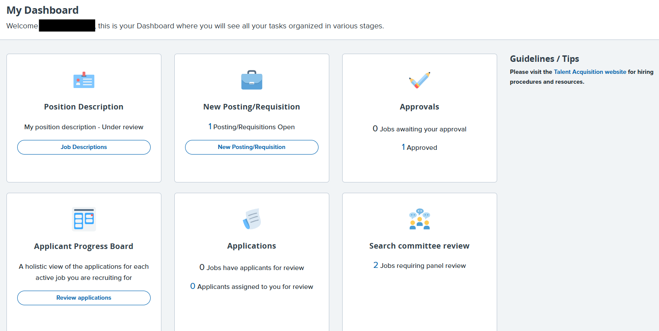
Viewing Applications
There are multiple ways to view applications within PageUp.

Slide 22
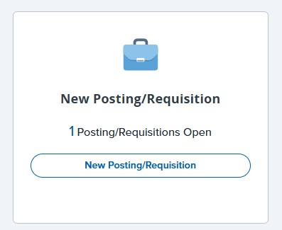
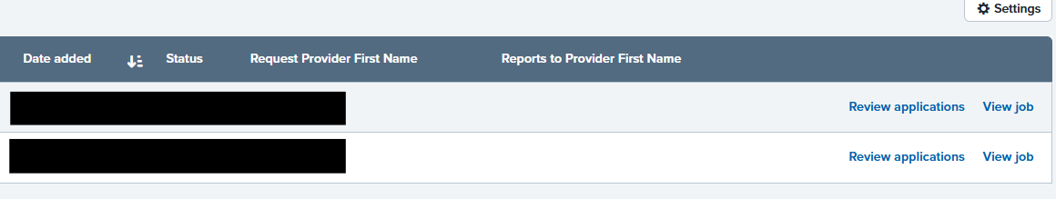
Viewing Applications
Option 1: Click " [number] Posting/Requisitions Open" select "Review Applications". ​

Slide 23
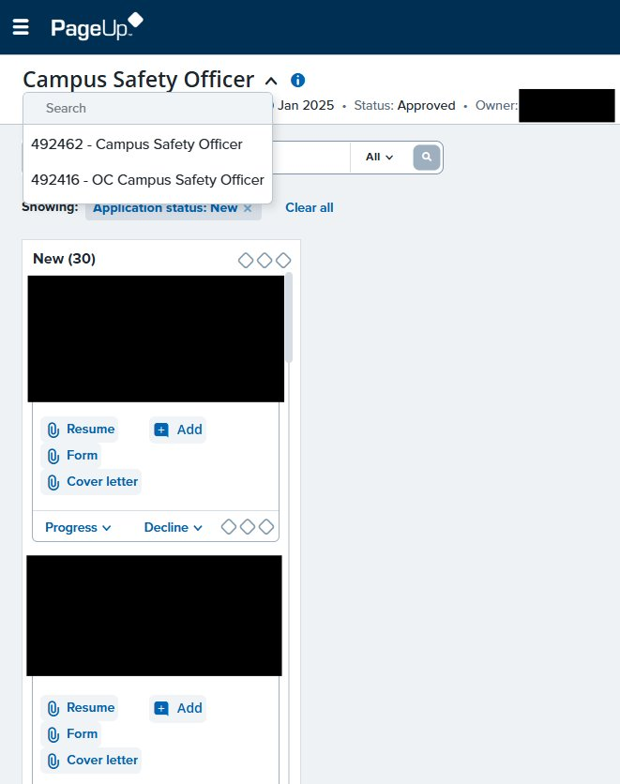
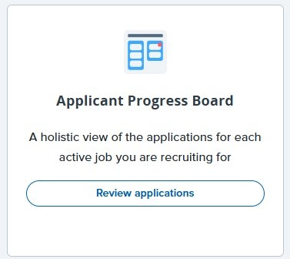
Viewing Applications
Option 2: Click "Review Applications" on Applicant Progress Board.
Go between jobs in the upper left-hand corner.

Slide 24
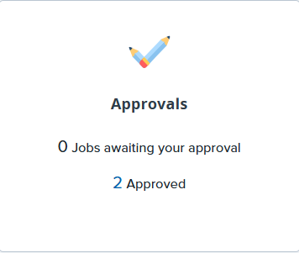
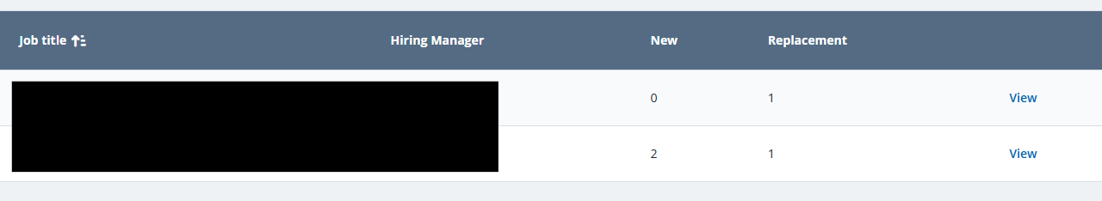
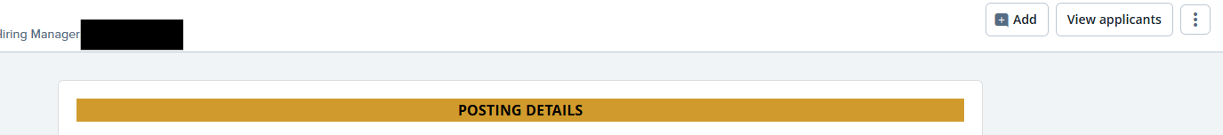
Viewing Applications
Option 2: Click "Review Applications" on Applicant Progress Board.
Click "view" next to the job you would like to see the applicants for.
Click "view applicants in top right corner.

Slide 25
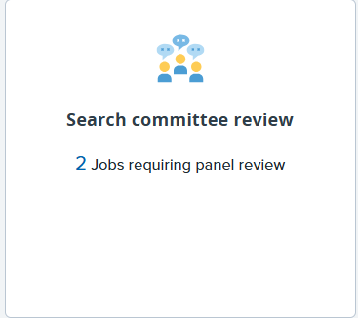
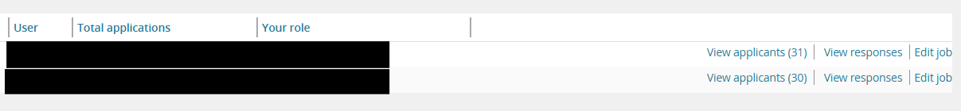
Viewing Applications
Option 4: Click "[number] Jobs requiring panel review" on Search committee review.
Click "View applicants"
Note: This view of applications is for reviewing the applicants and selecting if you would recommend them for an interview. You can move applicants with this option but ONLY in bulk.
Tip: By clicking "view responses", you can see if others on the search committee recommend the applicant for an interview.

Slide 26
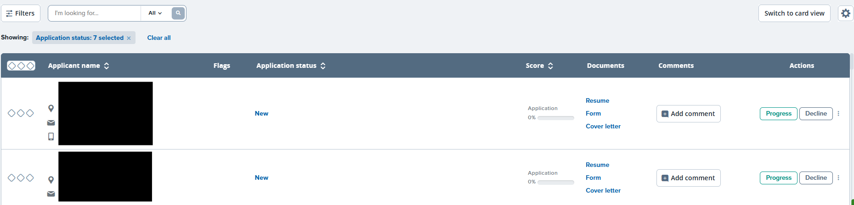
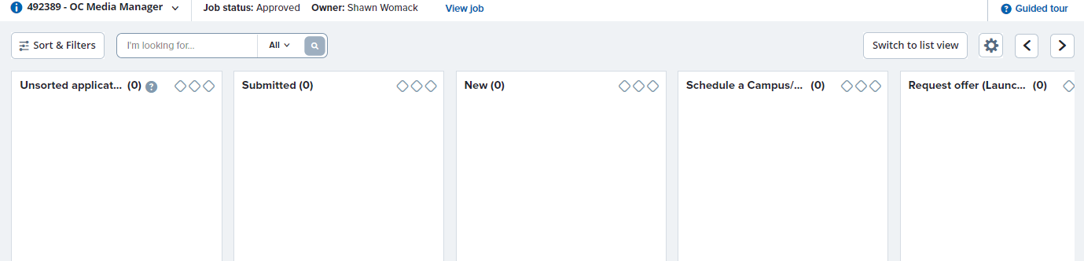
Viewing Applications
However you decide to view applications, you can change your view to "list" or "card".
List View:
Note: To change view, select "Switch to ___"
Card View:
Tip: When in card view, you can drag and drop applicants to different application status. It will ask you to confirm before it moves them.

Slide 27
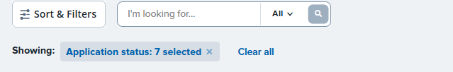
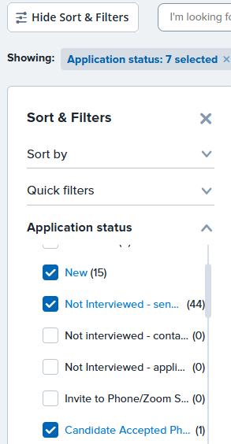
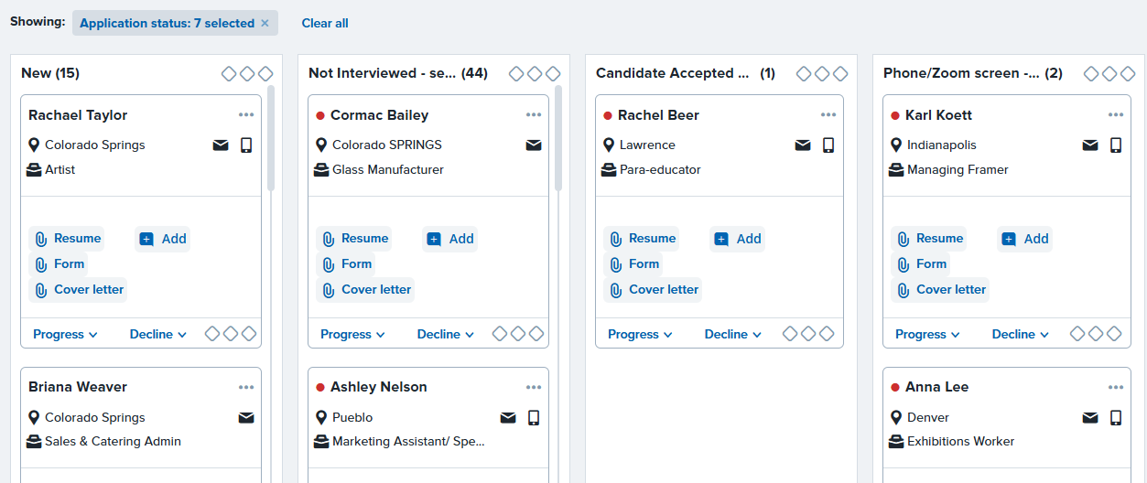
Viewing Applications
Utilize the "filters" feature to customize applicant search. You can apply a combination of filters to display only the applications that fit their filter criteria. Below is the card view, but you can also set filters in the list view
Note: Applications in "incomplete" status are not visible.

Slide 28
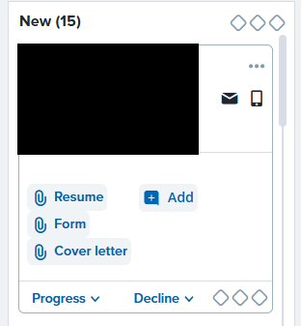
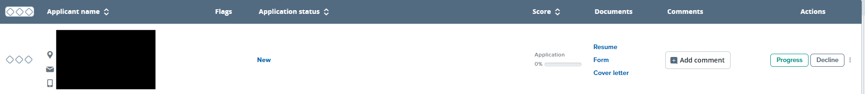
Viewing Applications
Card View:
These icons take you to the candidates contact information, or you can hover over the icon to see a quick view.
Click on "Resume, Form, or Cover letter" to view. Click "+Add " to add a comment about the application.
List View:

Slide 29
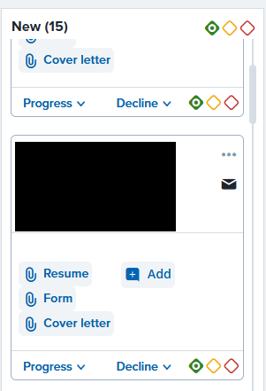
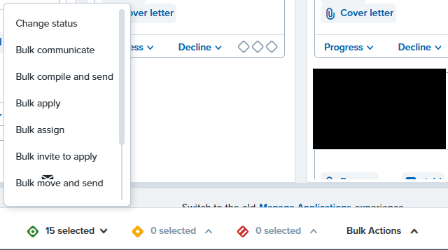
Managing Applications - Bulk Actions
These three diamond-shaped ellipsis at the top are a bulk selector. If you click on one of the buckets on the top, it will select all the applications in that particular status (in this case "new").
Once you click an ellipsis, the bottom of your screen will present bulk actions you can choose from. To de-select all, press "Esc" on your keyboard or click the ellipsis again.
Key:
Left diamond = Green
Middle diamond = Yellow
Right diamond = Red

Slide 30
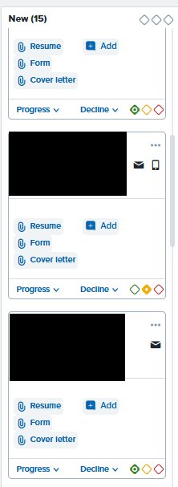
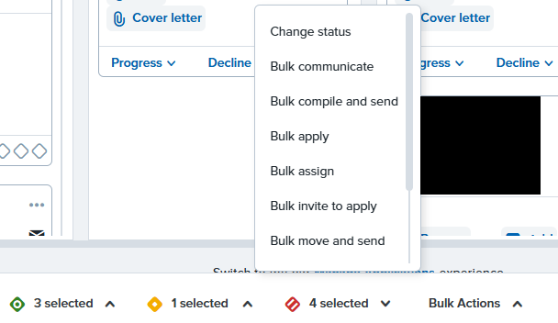
If you do not want to select the same bucket for all the applicants in a status, you can go through and select a bucket for each applicant.
Then at the bottom of the screen it will show how many applicants are selected in each bucket. Click that bucket to select a bulk action.

Slide 31
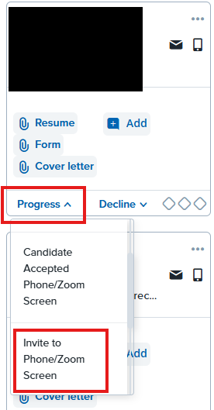
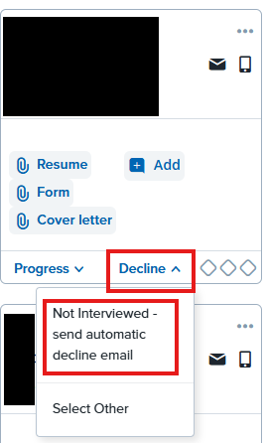
Managing Applications – Individual Actions
To move an individual applicant forward, go to their application and select "progress" and choose the correct status.
To decline an applicant, select "decline" and move them into the correct status.
Note: You can also use the three diamond-shaped ellipsis underneath the applicant's name for individual applicant management.

Slide 32
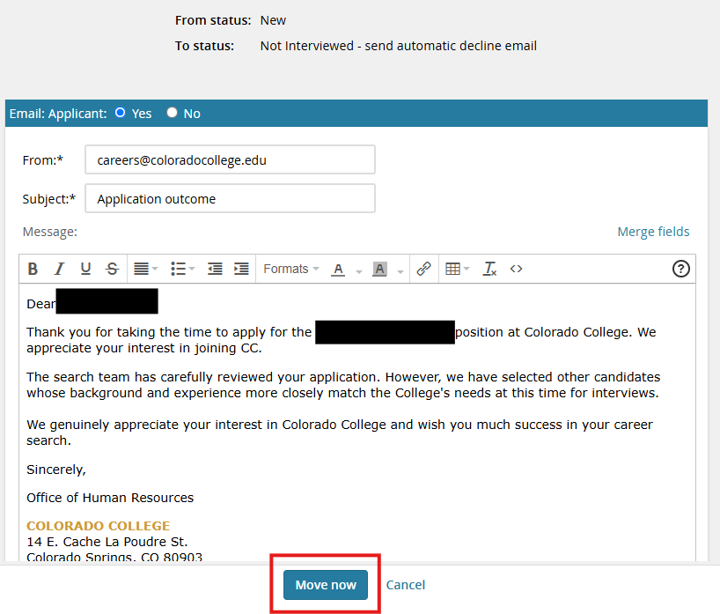
Some application statuses will send an automatic email. After you click on the status, another screen will pop up with the email.
You can review the email and make any edits if applicable. Once ready to send, click "Move now".

Slide 33
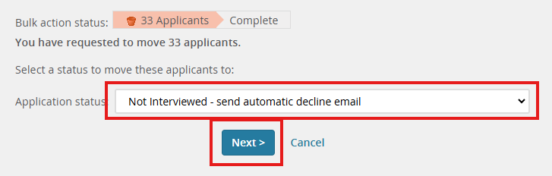
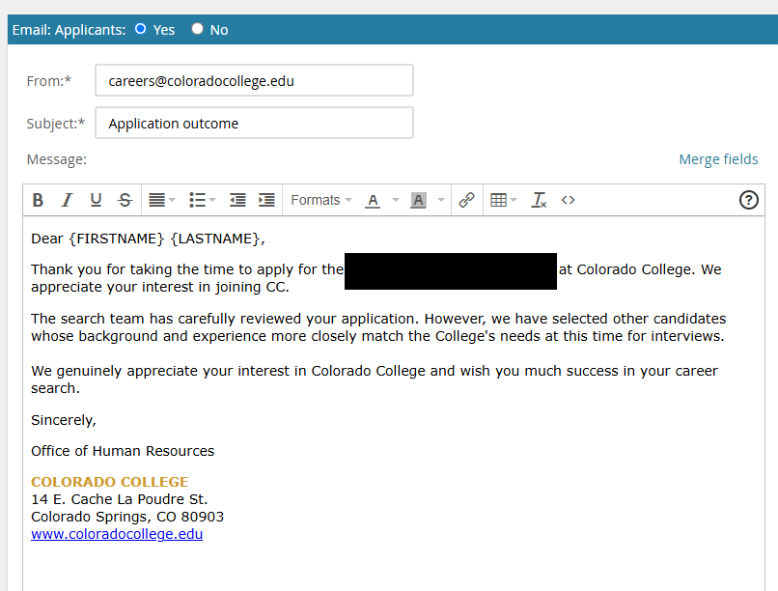
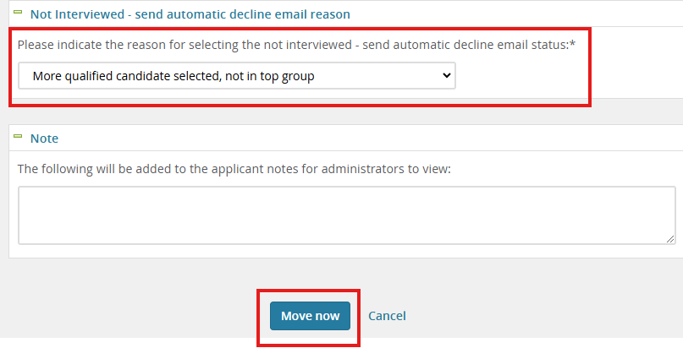
When moving applications in bulk, you will need to select the application status and click "Next". The email template will pop up and you can make edits if applicable.
Scroll to the bottom and choose the reason for your selection. Remember this is a bulk movement so it will be the same for all applicants. To send the emails click "Move now".
Note: Applicants will not see the reason you choose.

Slide 34
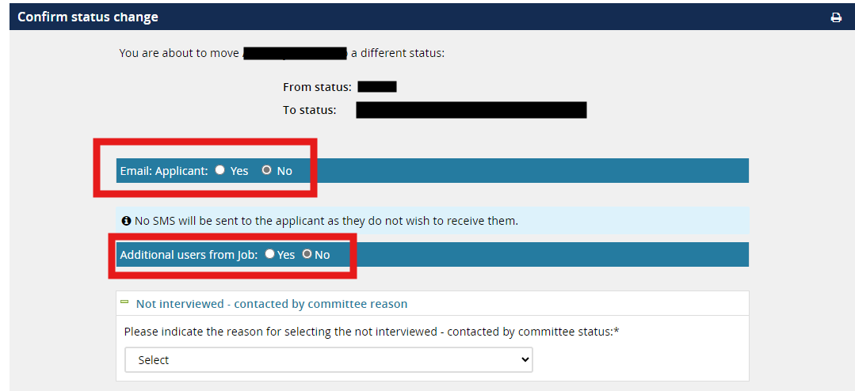
For any status change, be sure to pay special attention to who will be notified. Some status updates will notify the candidate, other changes will not. If you would like to send an email to additional users, such as search committee, you can here as well.

Slide 35
PageUp User Guide
Hiring Recommendations: Request Offer
Human Resources Department
People and Workplace Culture
Notes:
Note, these pptx modules are to be viewed from the perspective of the hiring manager.

Slide 36
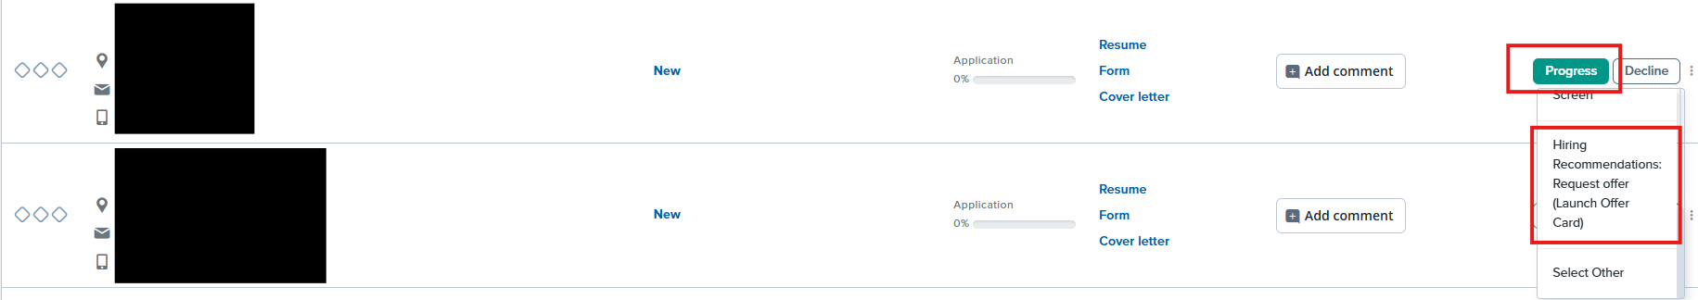
Hiring Recommendation
Congratulations on getting ready to extend an offer!
To get started, go to the candidate in card or list view. DO NOT click on the candidate's name. Find the "Progress" dropdown by their name and select "Hiring Recommendations: Request offer (Launch offer card)". If you don't see "Hiring Recommendations" click "Select Other"
You don't need to make any changes to the Confirm Status Change page. Click "Move now". This is just notifying HR that you are about to submit a hiring recommendation.

Slide 37
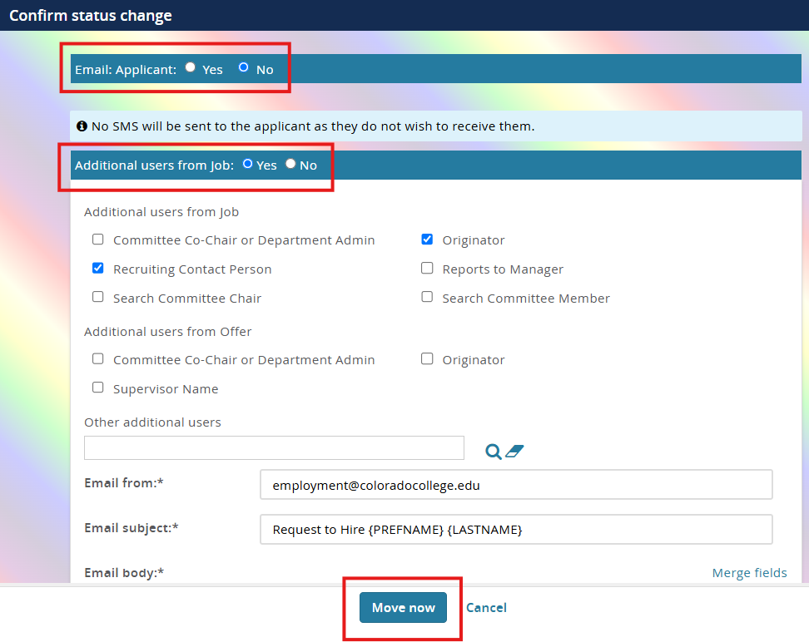
A confirm status change window will open. Make sure the "Email: Applicant" is selected as No.
Keep the "Additional users from Job" selected as Yes. This will send the email below to HR (and a copy to you) letting HR know a hiring recommendation is being started.
Click "Move now"

Slide 38
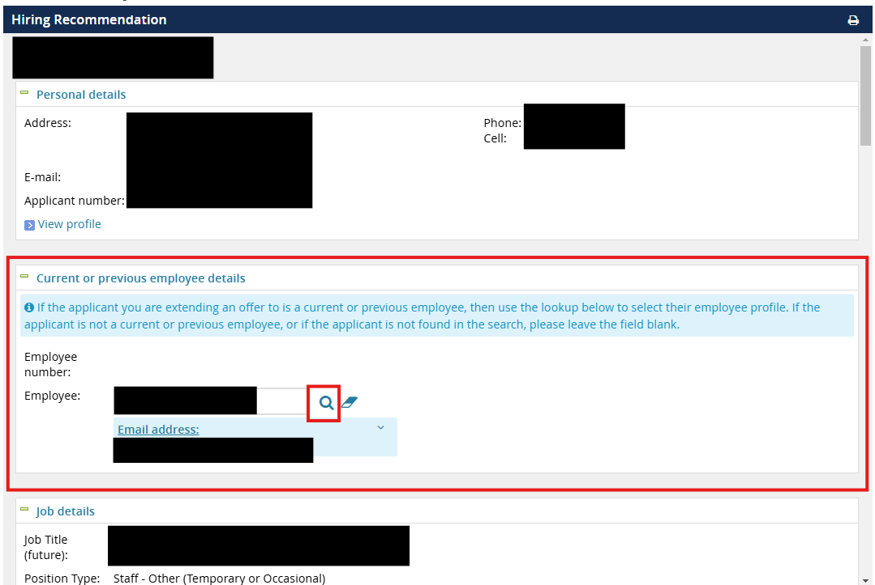
This will open the hiring recommendation or offer card.
If the candidate is a current or previous employee, please search for their name using the magnifying glass icon next to Employee:
If you are unable to find them using the search, go ahead and leave it blank. HR will double check.

Slide 39
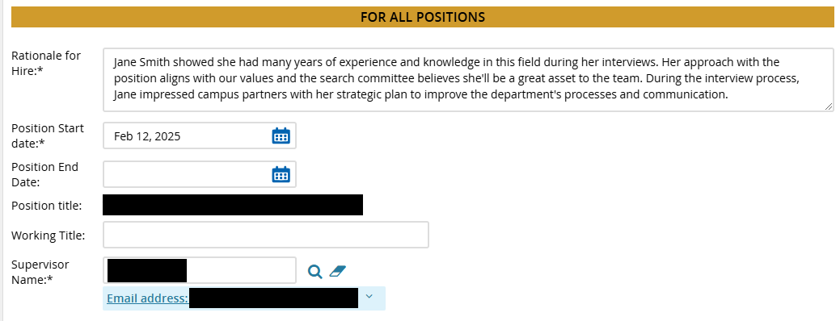
Fill out all mandatory fields (asterisks):
Rationale for Hire: this section should include specific information on why the candidate is qualified for this position.
Position Start date: this will be an estimated start date and will be confirmed once the candidate accepts the offer.

Slide 40


To add your documentation from the search, click "add document"
Click "Upload file" and select the document you would like to add.

Slide 41


Select the Document category from the dropdown menu. The most common categories will be Reference Checks and Interview Notes.
Do not select "Offer Contracts" as the category. This will allow the applicant to see those documents.
The title is option. Example: Application Review Rubric, Zoom Interviews
Click "Save and Add another" or "Save and close"

Slide 42

Submitting the hiring recommendation
At the very bottom of the screen within "Approval Process", select from the drop down as "Staff – Submit to HR". You should then see the approval process go through Compensation and Talent Acquisition. If the approval process is not selected, this will hold the hiring recommendation without notifying anyone.
Click "Save" to formally launch the offer card.

Slide 43


Viewing hiring recommendation
If you have forgotten to select the approval process on the hiring recommendation (slide 42) or you need to upload references and documentation after you've submitted the hiring recommendation to HR, follow the steps below. (Refer to slides 40-41 for upload instructions)
Click on "New hires" under Offers on dashboard. You will only have this if you are the new employee's supervisor.
Then "View offer details" to the far right of the new employee's name.

